Slide 1
ADOL – AML Reclamation Project
Sicard Hollow Road III
Joshua Therrien
ALG890000
11/21/2014
Jefferson County

Slide 2
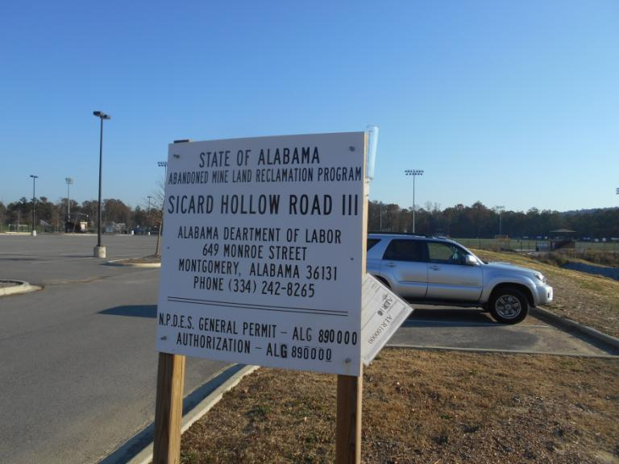

Slide 3
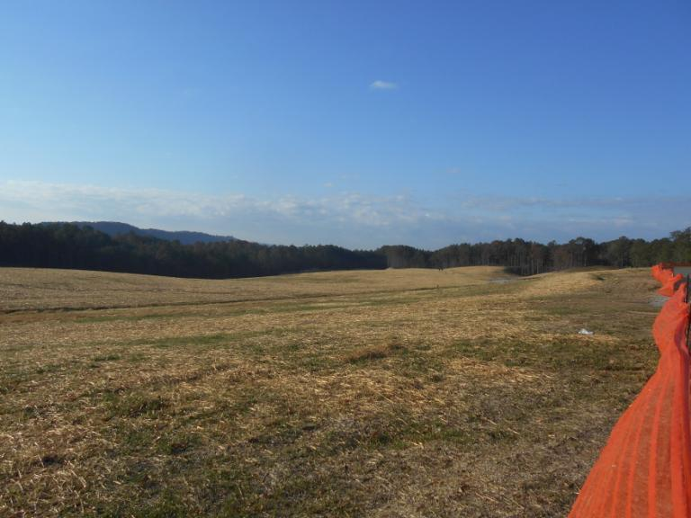
Site Overview

Slide 4
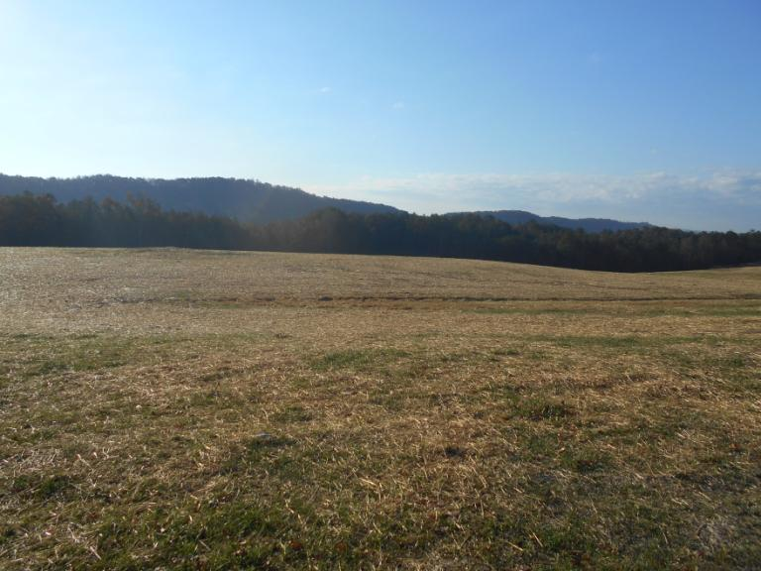
Site Overview

Slide 5
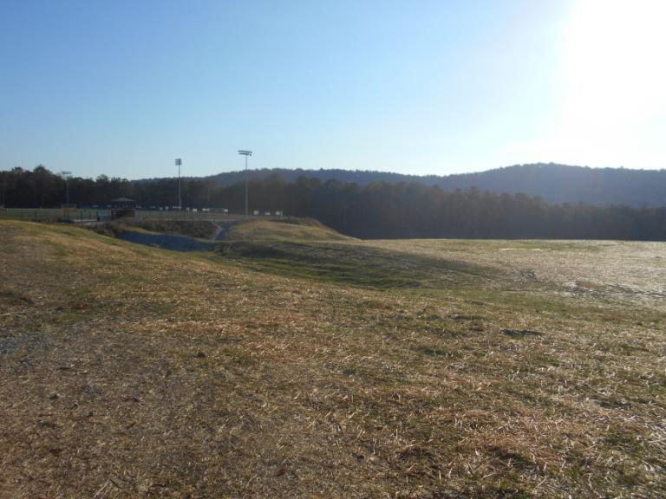
Site Overview

Slide 6
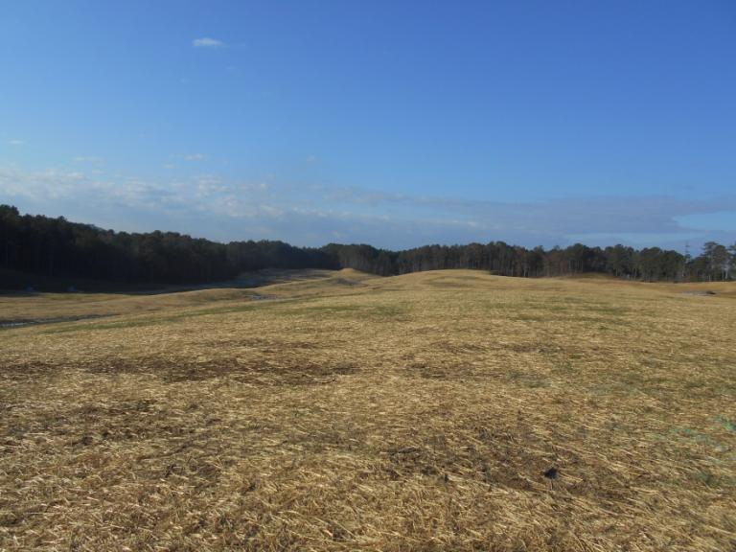
Site Overview

Slide 7
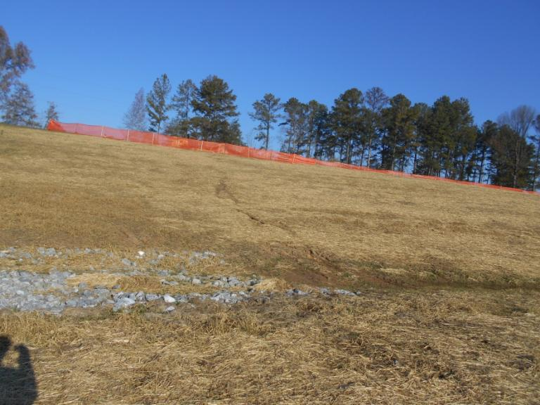
Erosion Rills on Slope

Slide 8
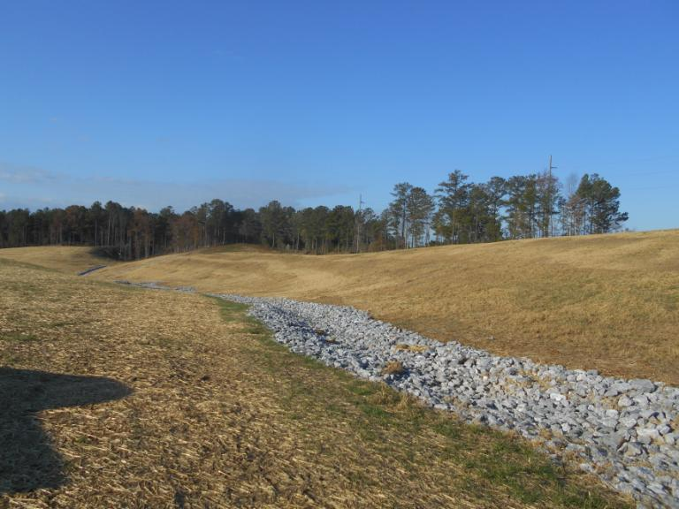
Rip-Rapped Drainage Ditch

Slide 9
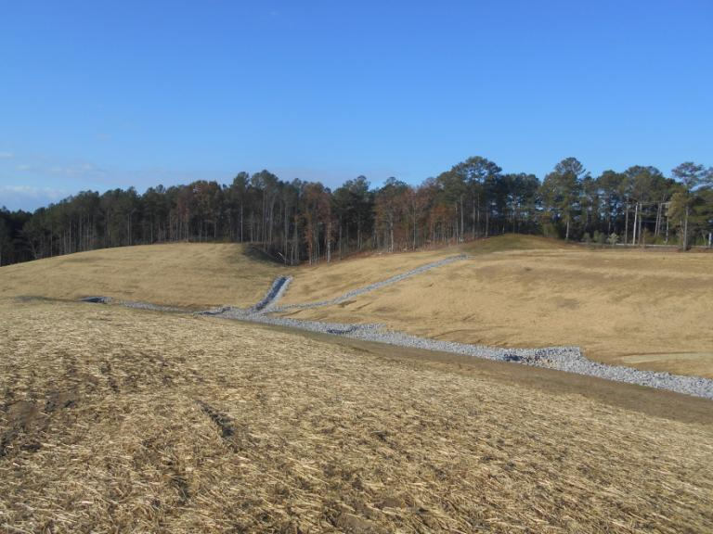
Rip-Rapped Drainage Ditch with Check Dams

Slide 10
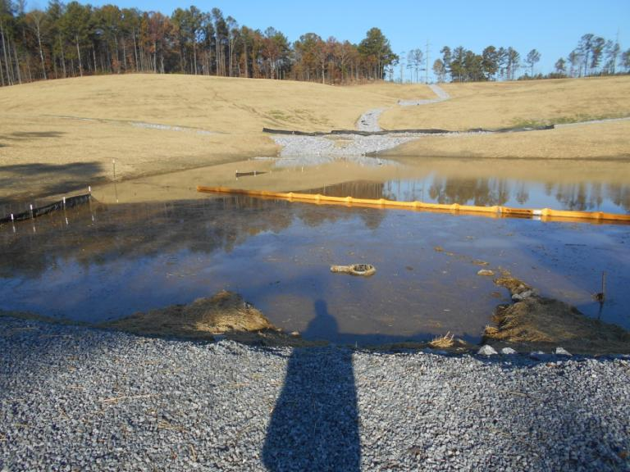
Sediment Basin 1

Slide 11
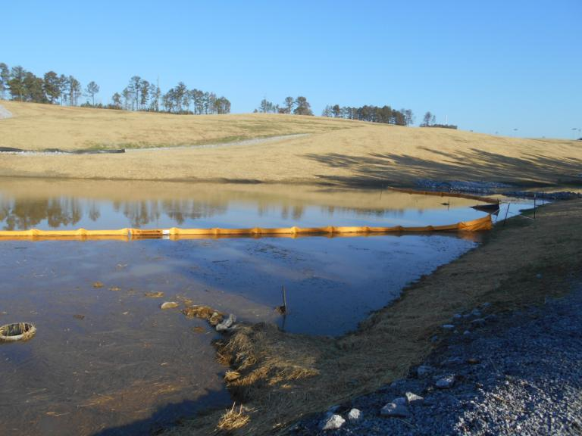
Sediment Basin 1

Slide 12
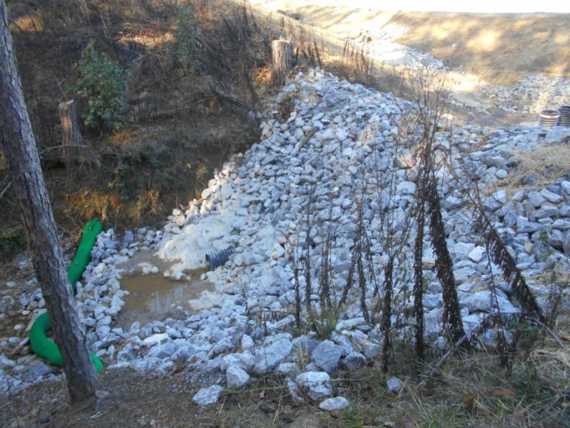
Sediment Basin 1 Discharge Point

Slide 13
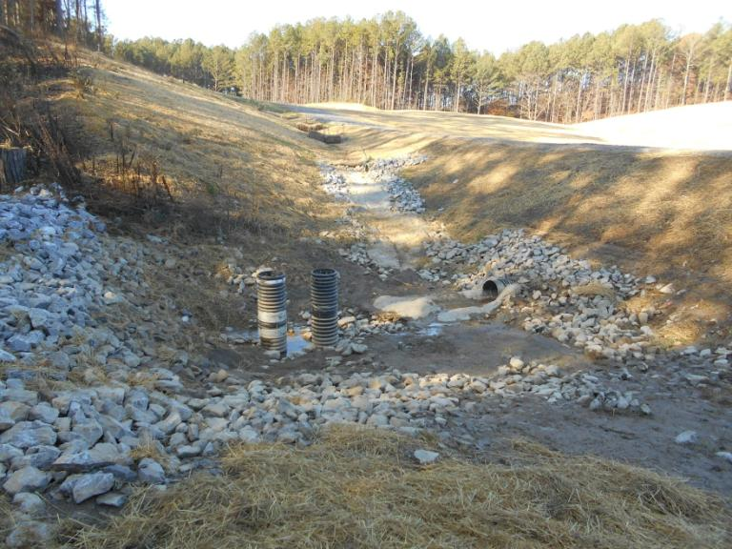
Sediment Basin 1 Discharge Point

Slide 14
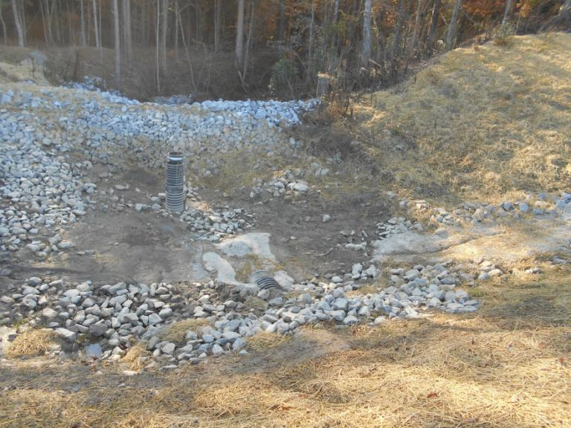
Sediment Basin 1 Discharge Point

Slide 15
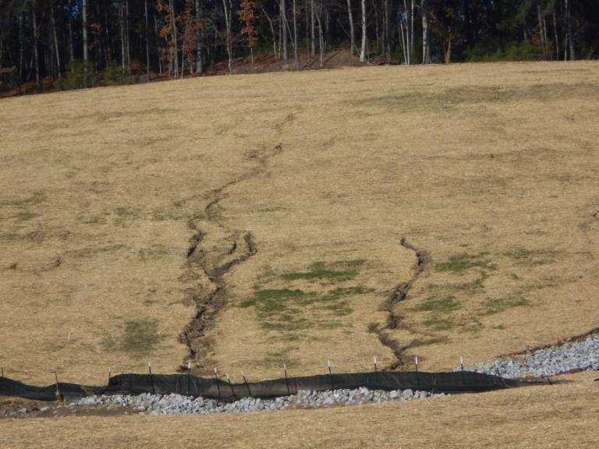
Slope Erosion

Slide 16
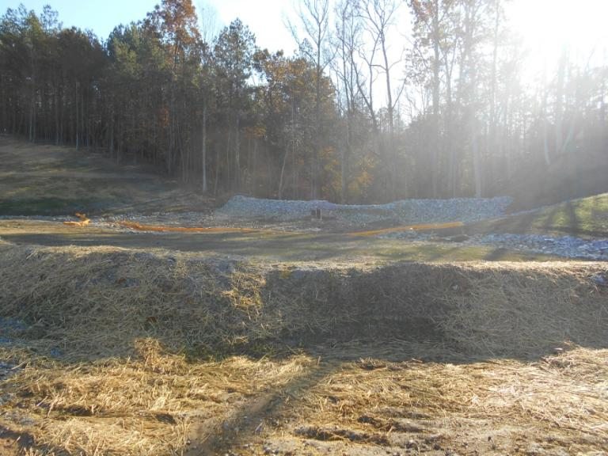
Sediment Trap

Slide 17
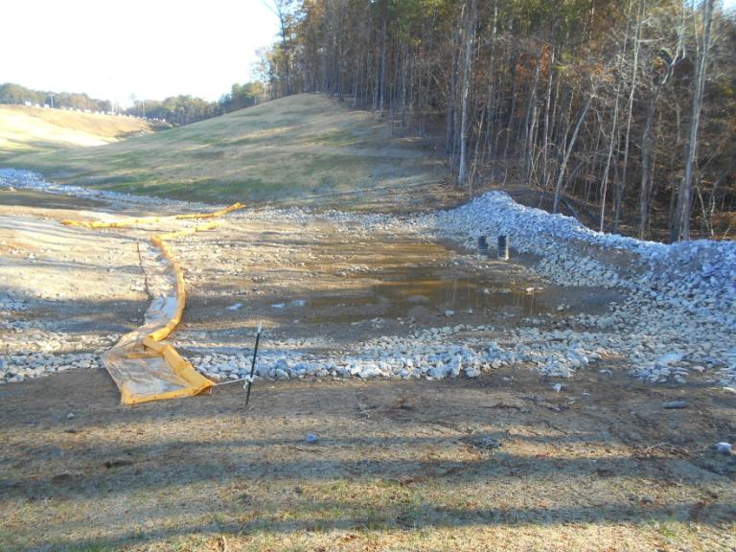
Sediment Trap

Slide 18
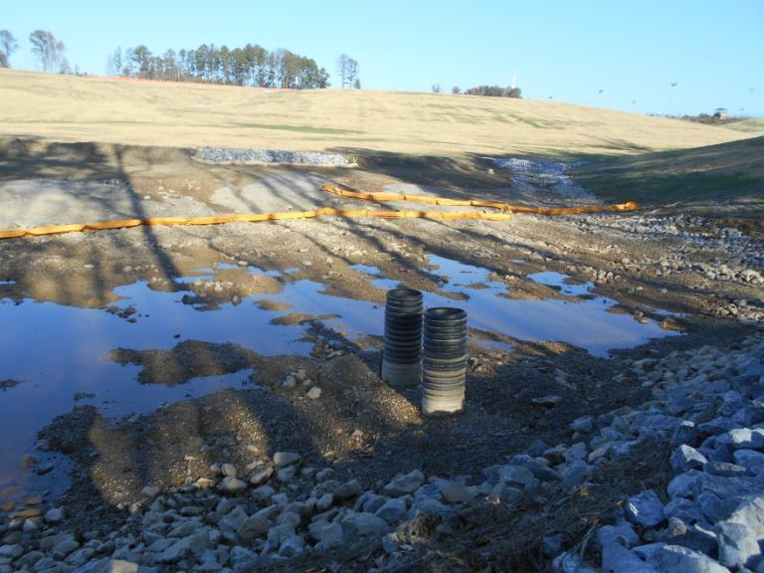
Sediment Trap

Slide 19
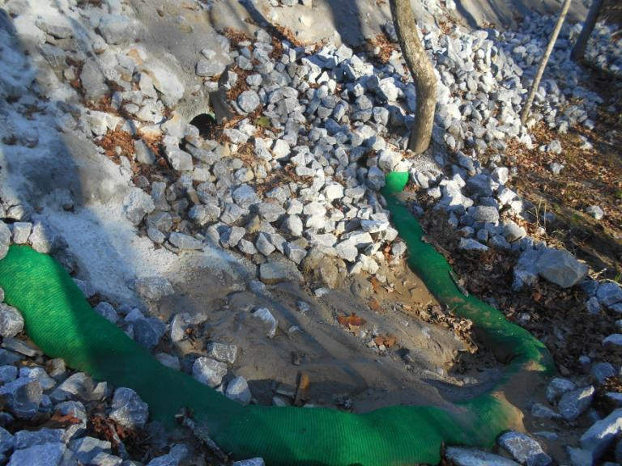
Sediment Trap Discharge Point

Slide 20
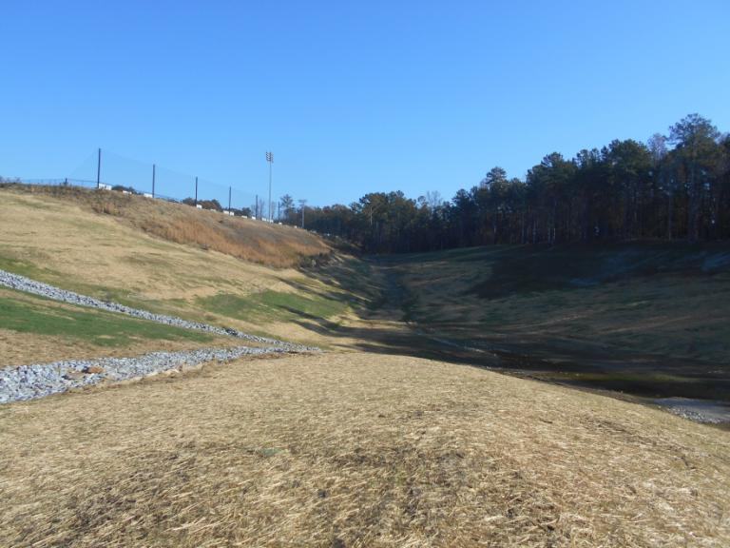
Drainage to Sediment Basin 2

Slide 21
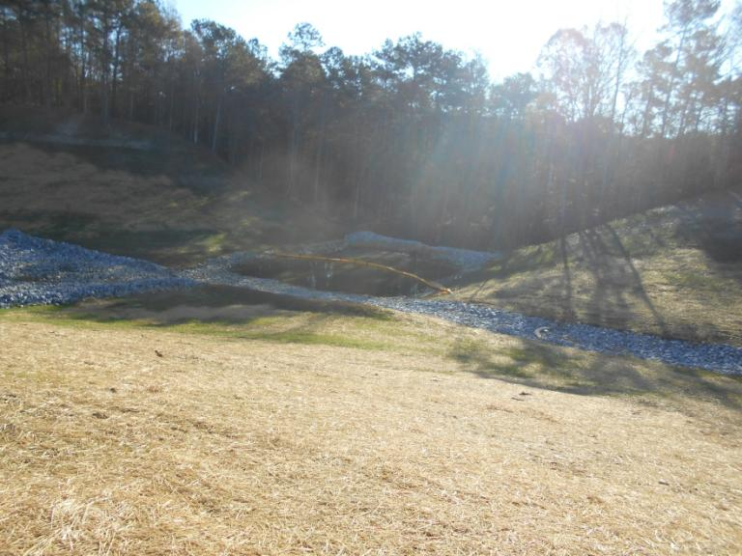
Sediment Basin 2

Slide 22
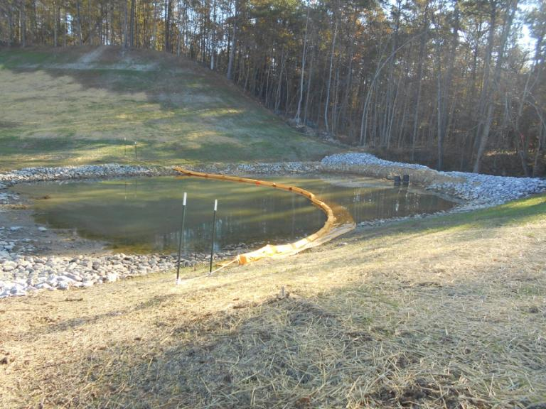
Sediment Basin 2

Slide 23
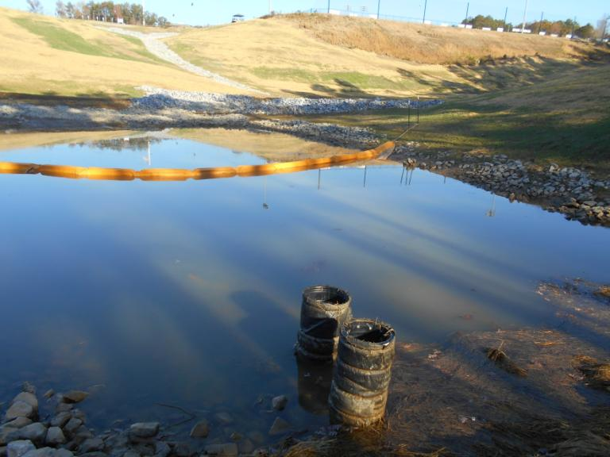
Sediment Basin 2

Slide 24
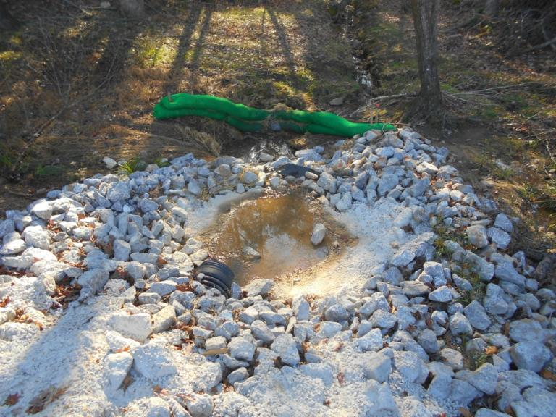
Sediment Basin 2 Discharge Point

